Slide 1


BUILD LANDING PAGES WITH OPENAI API, CLAUDE, & GEMINI

Slide 2

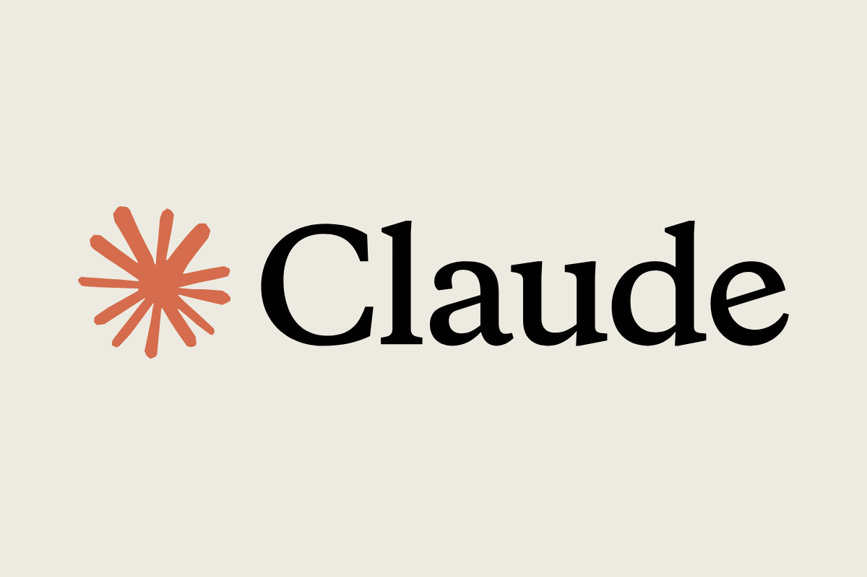

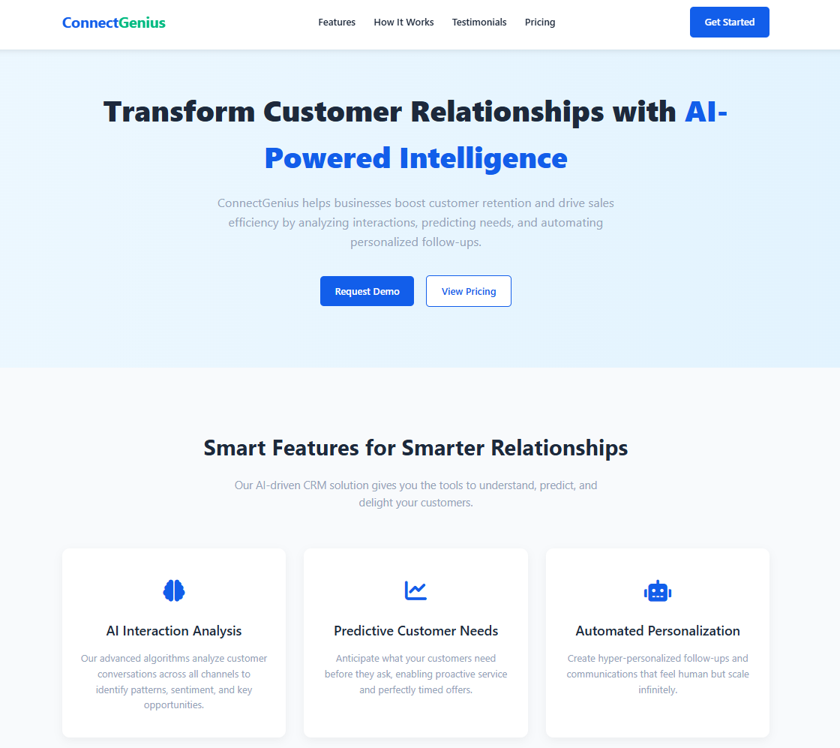

Project Overview
In our previous projects, we've explored interacting with OpenAI models and building Gradio interfaces. Now, let's broaden our horizons by working with multiple AI providers!
Different AI models have unique strengths, weaknesses, and "personalities." Sometimes, one model might give a better result for a specific task than another.
In this project, we will generate HTML landing pages for a startup using three major AI/LLMs providers: OpenAI, Google Gemini, and Anthropic Claude. We'll then compare the generated HTML structures.
Model Output
Startup Name
ConnectGenius
© All rights reserved for Dr. Ryan Ahmed @Stemplicity Inc.
Startup Concept
"An intelligent CRM system that uses AI to analyze customer interactions, predict needs, and automate personalized follow-ups. Focus on improving customer retention and sales efficiency for businesses of all sizes."

Slide 3

Key Learning Outcomes
Learn how to Setup & configure APIs for frontier LLMs such as OpenAI, Google Gemini, & Anthropic Claude.
Leverage frontier models to generate code and HTML pages and save the outputs in .html files.
Compare LLMs using Leaderboards (Vellum & Chatbot Arena) & Perform Blind Test.
Compare the math and creative capability of the frontier models.
© All rights reserved for Dr. Ryan Ahmed @Stemplicity Inc.

Slide 4
LEADERBOARDS FOR OPEN & CLOSED-SOURCE MODELS

Slide 5
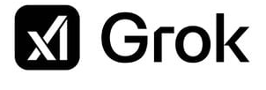


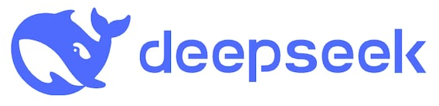
AI Models (LLMs) are everywhere!
Many LLMS are available, some are open source, and some are closed source. Which one should I go for?
© All rights reserved for Dr. Ryan Ahmed @Stemplicity Inc.

Slide 6
How to Compare LLMs?
Open-source or Closed
Closed (e.g. GPT-4) usually offers better performance and ease of use via APIs.
Context Length
How much input/output the model can handle in one go.
For long documents or multi-turn conversations, longer context is better (e.g., Gemini 2.5 Flash has 1M Window).
Release Date & Knowledge Cut-off
Newer models are trained on more recent data (useful for current events) (e.g.: GPT-3.5’s cut-off is early 2023.
Parameters
More parameters usually = more capacity (e.g., GPT-3 has 175B).
But bigger isn’t always better for performance or cost—efficiency matters too.
Training Tokens
Refers to how much text the model was trained on.
More tokens = broader language understanding and generalization
Open-source (e.g. LLaMA) gives you flexibility, full control, and lower cost if self-hosted.
© All rights reserved for Dr. Ryan Ahmed @Stemplicity Inc.

Slide 7
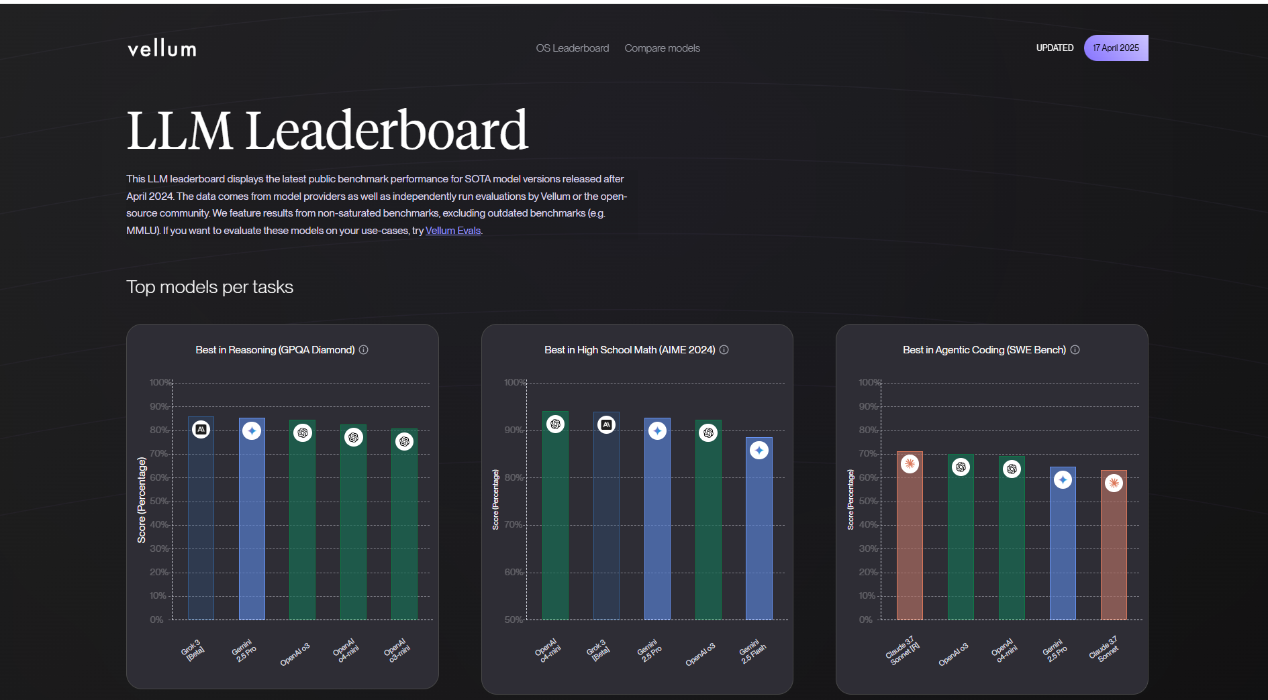
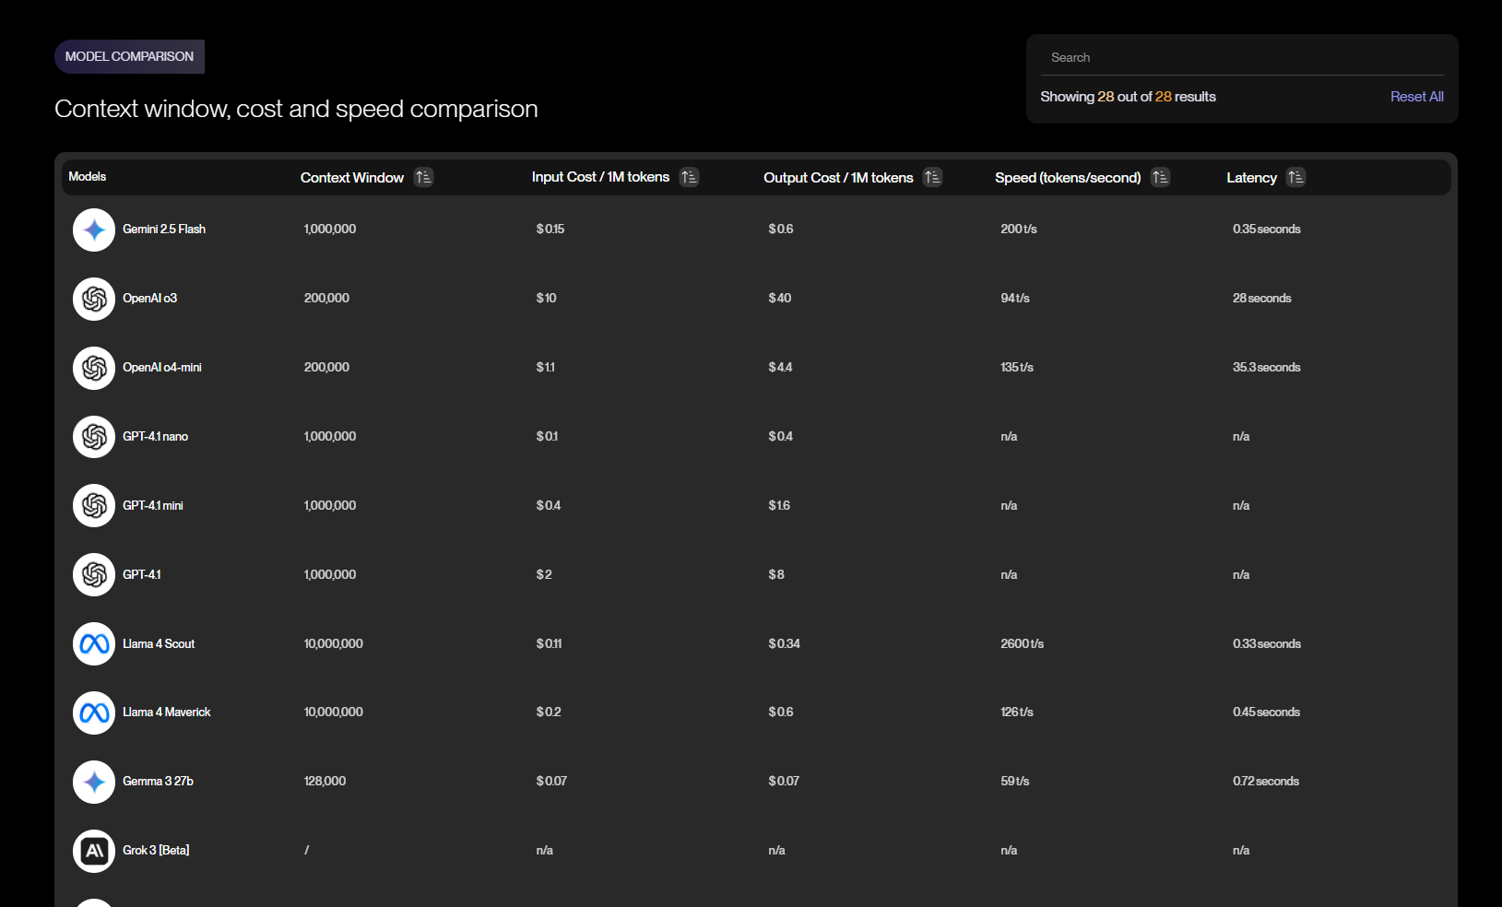
Vellum Leaderboard & Key KPIs
Vellum Leaderboard: https://www.vellum.ai/llm-leaderboard
© All rights reserved for Dr. Ryan Ahmed @Stemplicity Inc.

Slide 8
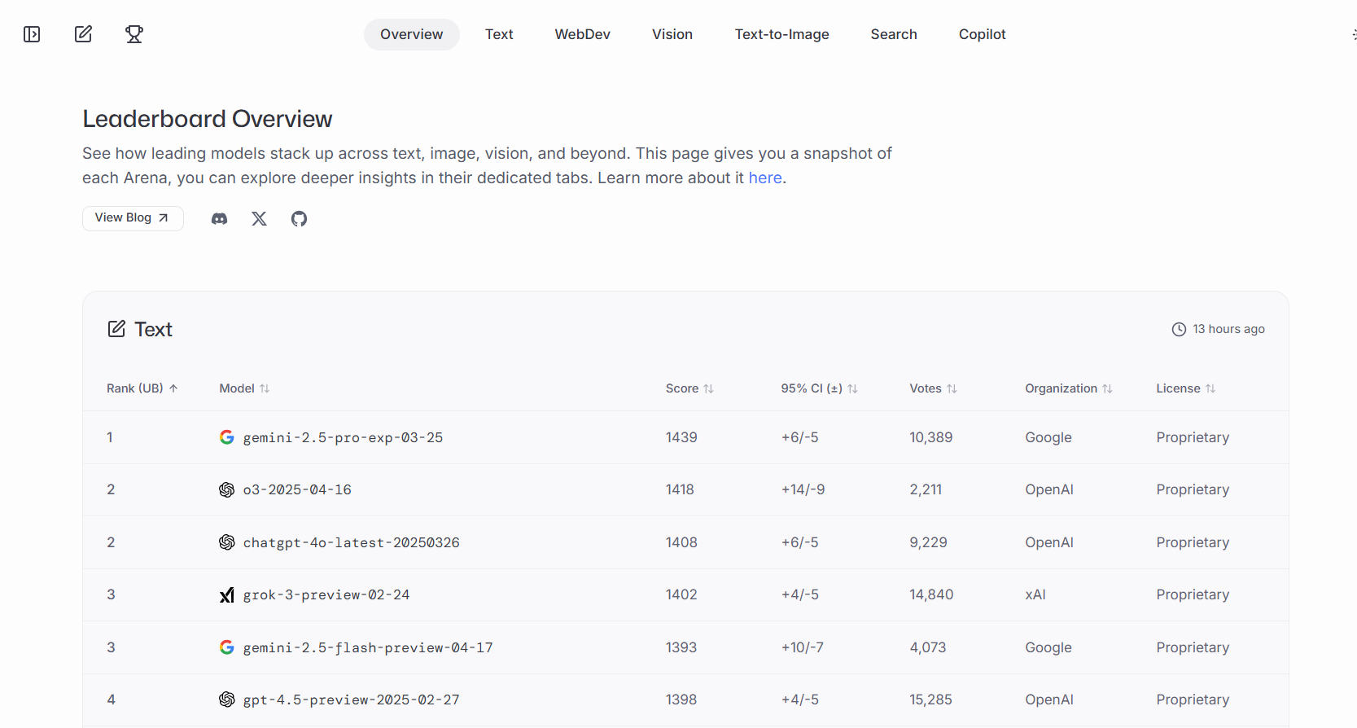
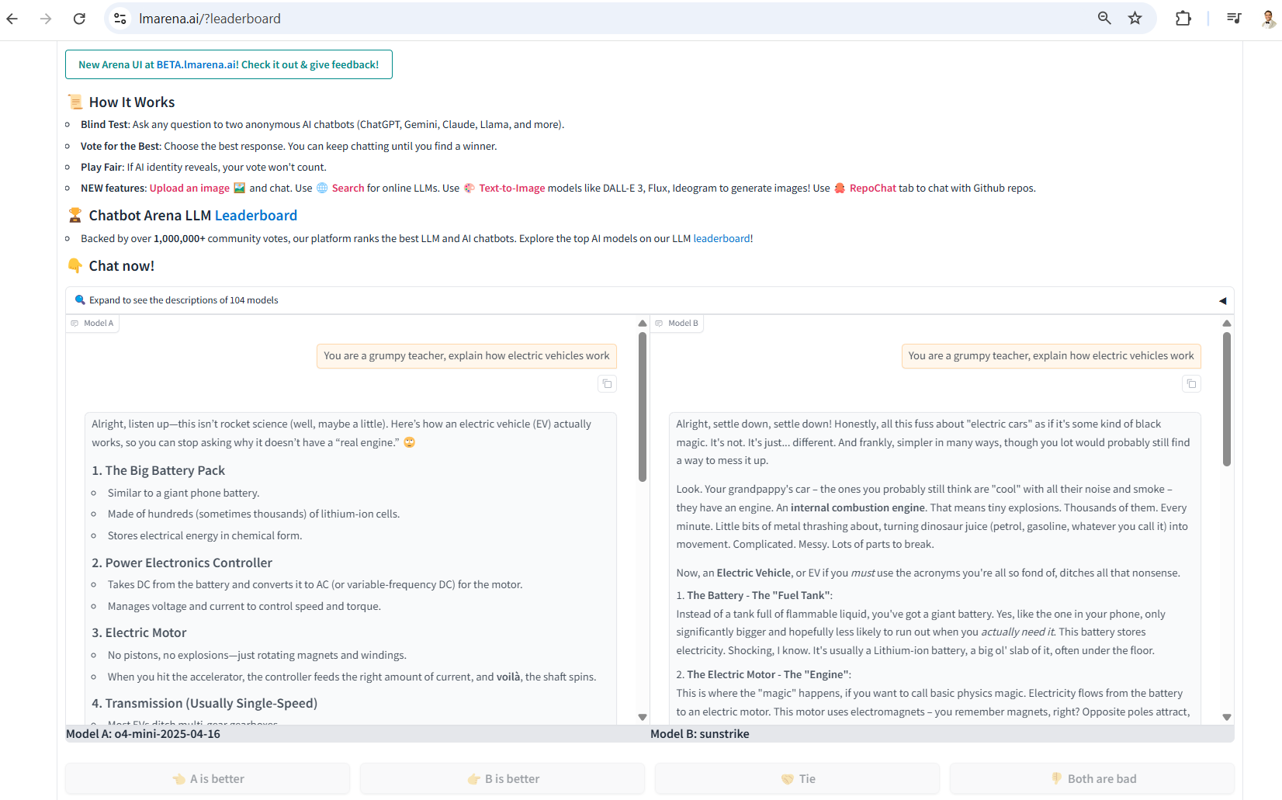
Chatbot Arena LLM Leaderboard & Blind Test!
Chatbot Arena (old): https://lmarena.ai/?leaderboard
Chatbot Arena (New): https://beta.lmarena.ai/leaderboard
© All rights reserved for Dr. Ryan Ahmed @Stemplicity Inc.

Slide 9

Summary
Frontier models like GPT, Claude, and Gemini differ significantly in both performance and cost so choosing the right one is as much an art as it is a science.
With the power of generative AI, you can now create stunning HTML landing pages with no coding required.
Large Language Models are compelling with their ability to code, solve complex math problems, and generate highly creative content.
You can compare state-of-the-art models using Leaderboards (Vellum) & perform blind tests using Chatbot Arena.
© All rights reserved for Dr. Ryan Ahmed @Stemplicity Inc.

Slide 10
Thank you!

